Slide 1

Portfolio Performance Overview
Last updated on the 22 December 2025 at 12:11 PM

Slide 2
Trade Plan and Brokerage Overview
Total Portfolio: $102,346.29 (-182.71) Total Brokerage: $198.00 Net Invested: $102,512.11 (-110.98)
Security | Current | Target | Change | Last Price | Brokerage | Cash Flow
A200 | 30 | 25 | -5 | $145.63 | $0.00 | -$728.15
IEU | 30 | 88 | 58 | $102.99 | $0.00 | $5,973.42
IJP | 30 | 5 | -25 | $125.68 | $0.00 | -$3,142.00
IOO | 30 | 47 | 17 | $188.42 | $0.00 | $3,203.14
IVV | 30 | 107 | 77 | $69.01 | $0.00 | $5,313.77
MTUM | 30 | 23 | -7 | $29.05 | $0.00 | -$203.35
MVW | 30 | 49 | 19 | $38.64 | $0.00 | $734.16
QHAL | 30 | 57 | 27 | $53.00 | $0.00 | $1,431.00
QLTY | 30 | 156 | 126 | $33.37 | $0.00 | $4,204.62
QUAL | 30 | 78 | 48 | $62.26 | $0.00 | $2,988.48
SMH | 30 | 2 | -28 | $538.01 | $0.00 | -$15,064.40
Security | Current | Target | Change | Last Price | Brokerage | Cash Flow
SMLL | 30 | 1101 | 1071 | $4.74 | $0.00 | $5,076.54
SPY | 30 | 1 | -29 | $1,027.90 | $0.00 | -$29,808.96
VAS | 30 | 32 | 2 | $108.46 | $0.00 | $216.92
VDHG | 30 | 110 | 80 | $74.23 | $0.00 | $5,938.40
VGE | 30 | 106 | 76 | $90.40 | $0.00 | $6,870.78
VGS | 30 | 57 | 27 | $154.69 | $0.00 | $4,176.63
VLU | 30 | 0 | -30 | $319.43 | $0.00 | -$9,582.85
VLUE | 30 | 158 | 128 | $33.67 | $0.00 | $4,309.12
VMIN | 30 | 116 | 86 | $63.24 | $0.00 | $5,438.64
VSO | 30 | 65 | 35 | $78.10 | $0.00 | $2,733.33
VVLU | 30 | 27 | -3 | $81.68 | $0.00 | -$245.05
Cash: -166 AUD

Slide 3
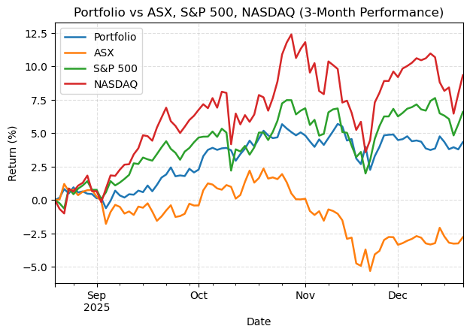
Portfolio Performance

